Slide 1
The Art of Styling Sentences
Skill Comes From Practice

Slide 2
A note about dependent vs. independent clauses
Independent Clauses
Subject
Verb
Complete thought
Dependent Clauses
Subject
Verb
Incomplete thought

Slide 3
Examples of each type
Independent
Dependent
The concert was really fun.
Texas is better than Oklahoma.
Students who bring me Dr. Pepper make me happy.
When I was moshing,
Which made the Sooner cry.
Because I love Dr. Pepper.
Who bring me Dr. Pepper

Slide 4
The Twenty Patterns
Pattern 1: Compound Sentence with Semicolon and No Conjunction
(two short, related independent clauses now joined)
S V_ ; S V .
Examples:
Reading is the easy part; remembering takes more effort.
“My forefathers didn’t come over on the Mayflower; they met the boat.” ~Mark Twain

Slide 5
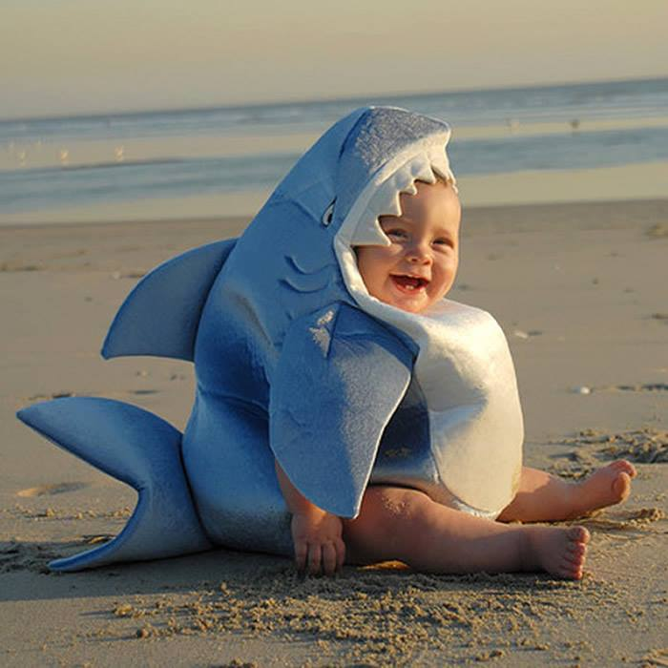
Write your own Pattern 1

Slide 6
The Twenty Patterns
Pattern 1a: Compound Sentence with Conjunctive Adverb (Connector)
S V ; (conjunctive adverb), S V
(You will need a semicolon before the connector, and a comma after the connector is often used, but optional.)
Examples:
Gary couldn’t go away for his vacation; however, he managed to have a good time at home.
“I think; therefore I am.” ~ Rene Descartes

Slide 7
Conjunctive Adverbs
however, hence, therefore, thus, then, moreover, nevertheless, likewise, consequently, and accordingly

Slide 8
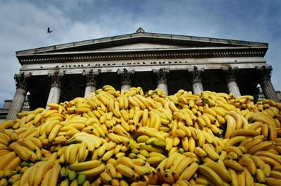
Write your own Pattern 1a

Slide 9
The Twenty Patterns
Pattern 1b: Compound Sentence with Coordinating Conjunction (Also Connector)
S V , (coordinating conjunction)
S V .
Examples:
The mouse ran across the floor, but I wasn’t scared.
“Good communication is as stimulating as black coffee, and it is just as hard to sleep after.” ~Anne Morrow Lindbergh

Slide 10
Coordinating Conjunctions
FANBOYS
for, and, nor, but, or, yet, or so

Slide 11
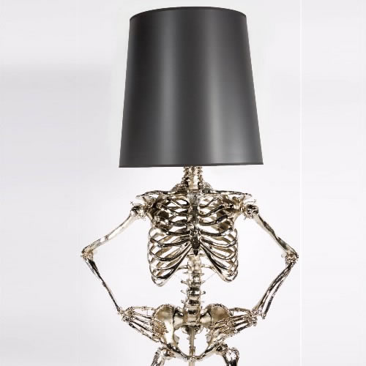
Write your own Pattern 1b

Slide 12
The Twenty Patterns
Pattern 1c: Compound Sentence with Two or More Semicolons
S V ; S V ; S V .
Examples:
Carmen likes to cook; Janice would rather watch TV; I like to eat while watching TV.
“He was naturally learned; he needed not the spectacles of books to read Nature; he looked inwards and found her there.” ~ John Dryden

Slide 13
Write your own Pattern 1c

Slide 14
The Twenty Patterns
Pattern 2: Compound Sentence with Elliptical Construction (comma indicates the omitted verb)
S V DO or SC ; S , DO or SC .
(omitted verb)
Examples:
For many of us, the new math teacher was a savior; for others, a pain.
The zombies ate the corpse; the vultures, the bones.
“Thought is the blossom; language[,] the bud; action [,] the fruit.” ~ Ralph Waldo Emerson

Slide 15
DO- Direct Object
Receives the action of the verb
He threw the ball.
The zombies ate the corpse.
SC- Subject Complement
Describes the subject
The girl is fascinating.
Ms. Kelley is a teacher.

Slide 16
Write your own Pattern 2

Slide 17
The Twenty Patterns
Pattern 3: Compound Sentence with Explanatory Statement (clauses separated by a colon)
General statement (idea) : specific statement (example).
(an independent clause) (an independent clause)
Examples:
The bouquet was special: it contained the roses she loved best.
“Old cars and young children have several things in common: both are a responsibility and have to be fed often or they break down.” ~ Claudia Glenn Downing

Slide 18
Write your own Pattern 3

Slide 19
The Twenty Patterns
Pattern 4: A Series Without A Conjunction
A, B, C .
Examples:
The pitcher threw his fastball, his slider, his curve ball.
“I have come to you without sin, without guile, without evil, without a witness against me.” ~The Book of the Dead

Slide 20
Write your own Pattern 4

Slide 21
The Twenty Patterns
Pattern 5: A Series of Balanced Pairs
(note the rhythm)
A and B , C and D , E and F .
(may be in any slot in the sentence)
Examples:
Antony and Cleopatra, Romeo and Juliet, Tristan and Isolde, Lancelot and Guinevere were all famous lovers in literature.
“We will fashion “crazy wisdom” from both secular and spiritual sources, both ancient and modern, and from Eastern and Western cultures…” ~ Wes Nisker

Slide 22
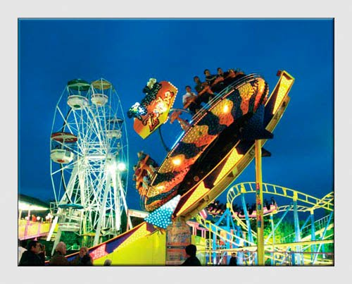
Write your own Pattern 5

Slide 23
The Twenty Patterns
Pattern 6: An Introductory Series Of Appositives
(with a dash and a summarizing subject)
Appositive, appositive, appositive – summary word S V.
(The key summarizing word before the subject may be one of these: such, all, those, this, many, each, which, what, these, something, someone. Sometimes the summary word will be the subject, but other times it will merely modify the subject.)

Slide 24
The Twenty Patterns
Pattern 6 Examples:
Twitter, Facebook, email – which should he use?
“What it comes down to is this: the grocer, the butcher, the baker, the merchant, the landlord, the druggist, the liquor dealer, the policeman, the doctor, the city father and the politician – these are the people who make money out of prostitution, these are the real reapers of the wages of sin.”
~ A House Is Not a Home

Slide 25
Write your own Pattern 6

Slide 26
The Twenty Patterns
Pattern 7: AN INTERNAL SERIES OF APPOSITIVES OR MODIFIERS
(enclosed by a pair of dashes or parentheses)
S - appositive, appositive, appositive - V .
OR
S ( modifier, modifier, modifier) V .
Examples:
My favorite red wines – Zinfandel, Cabernet Sauvignon, Pinot Noir – account for most sales in California.
The basic writing skills (good vocabulary, knowledge of grammar, sense of style) can be learned by almost everyone.

Slide 27
Write your own Pattern 7

