Slide 1
The Art of Styling Sentences
Skill Comes From Practice

Slide 2
A note about dependent vs. independent clauses
Independent Clauses
Subject
Verb
Complete thought
Dependent Clauses
Subject
Verb
Incomplete thought

Slide 3
Examples of each type
Independent
Dependent
The concert was really fun.
Texas is better than Oklahoma.
Students who bring me Dr. Pepper make me happy.
When I was moshing,
Which made the Sooner cry.
Because I love Dr. Pepper.
Who bring me Dr. Pepper

Slide 4
The Twenty Patterns
Pattern 1: Compound Sentence with Semicolon and No Conjunction
(two short, related independent clauses now joined)
S V_ ; S V .
Examples:
Reading is the easy part; remembering takes more effort.
“My forefathers didn’t come over on the Mayflower; they met the boat.” ~Mark Twain

Slide 5
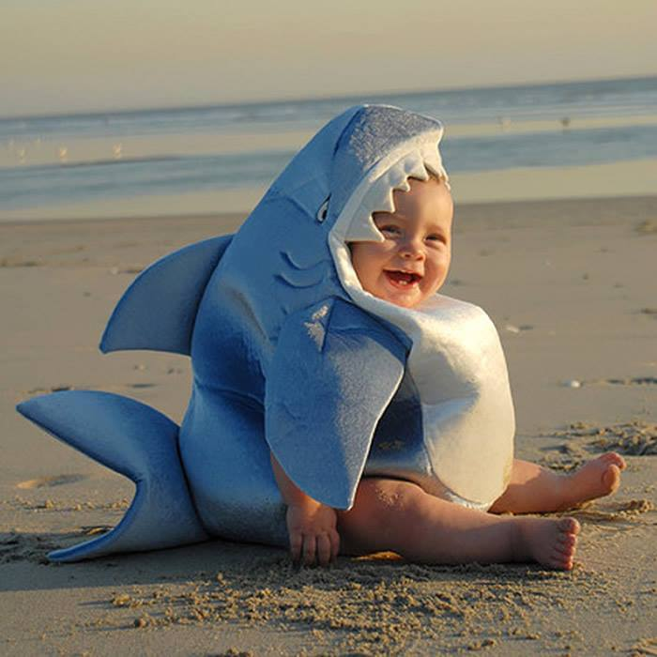
Write your own Pattern 1

Slide 6
The Twenty Patterns
Pattern 1a: Compound Sentence with Conjunctive Adverb (Connector)
S V ; (conjunctive adverb), S V
(You will need a semicolon before the connector, and a comma after the connector is often used, but optional.)
Examples:
Gary couldn’t go away for his vacation; however, he managed to have a good time at home.
“I think; therefore I am.” ~ Rene Descartes

Slide 7
Conjunctive Adverbs
however, hence, therefore, thus, then, moreover, nevertheless, likewise, consequently, and accordingly

Slide 8
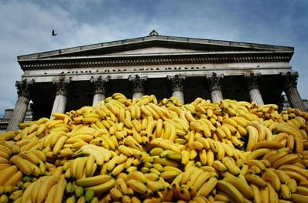
Write your own Pattern 1a

Slide 9
The Twenty Patterns
Pattern 1b: Compound Sentence with Coordinating Conjunction (Also Connector)
S V , (coordinating conjunction)
S V .
Examples:
The mouse ran across the floor, but I wasn’t scared.
“Good communication is as stimulating as black coffee, and it is just as hard to sleep after.” ~Anne Morrow Lindbergh

Slide 10
Coordinating Conjunctions
FANBOYS
for, and, nor, but, or, yet, or so

Slide 11
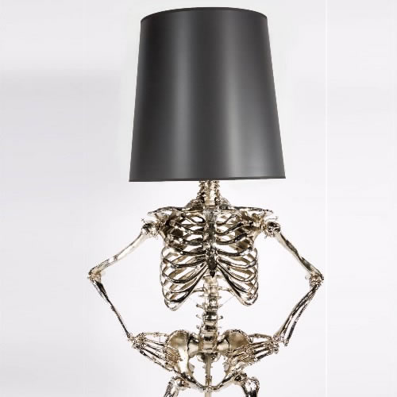
Write your own Pattern 1b

Slide 12
The Twenty Patterns
Pattern 1c: Compound Sentence with Two or More Semicolons
S V ; S V ; S V .
Examples:
Carmen likes to cook; Janice would rather watch TV; I like to eat while watching TV.
“He was naturally learned; he needed not the spectacles of books to read Nature; he looked inwards and found her there.” ~ John Dryden

Slide 13
Write your own Pattern 1c

Slide 14
The Twenty Patterns
Pattern 2: Compound Sentence with Elliptical Construction (comma indicates the omitted verb)
S V DO or SC ; S , DO or SC .
(omitted verb)
Examples:
For many of us, the new math teacher was a savior; for others, a pain.
The zombies ate the corpse; the vultures, the bones.
“Thought is the blossom; language[,] the bud; action [,] the fruit.” ~ Ralph Waldo Emerson

Slide 15
DO- Direct Object
Receives the action of the verb
He threw the ball.
The zombies ate the corpse.
SC- Subject Complement
Describes the subject
The girl is fascinating.
Ms. Kelley is a teacher.

Slide 16
Write your own Pattern 2

Slide 17
The Twenty Patterns
Pattern 3: Compound Sentence with Explanatory Statement (clauses separated by a colon)
General statement (idea) : specific statement (example).
(an independent clause) (an independent clause)
Examples:
The bouquet was special: it contained the roses she loved best.
“Old cars and young children have several things in common: both are a responsibility and have to be fed often or they break down.” ~ Claudia Glenn Downing

Slide 18
Write your own Pattern 3

Slide 19
The Twenty Patterns
Pattern 4: A Series Without A Conjunction
A, B, C .
Examples:
The pitcher threw his fastball, his slider, his curve ball.
“I have come to you without sin, without guile, without evil, without a witness against me.” ~The Book of the Dead

Slide 20
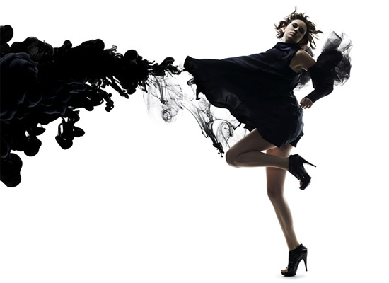
Write your own Pattern 4

Slide 21
The Twenty Patterns
Pattern 5: A Series of Balanced Pairs
(note the rhythm)
A and B , C and D , E and F .
(may be in any slot in the sentence)
Examples:
Antony and Cleopatra, Romeo and Juliet, Tristan and Isolde, Lancelot and Guinevere were all famous lovers in literature.
“We will fashion “crazy wisdom” from both secular and spiritual sources, both ancient and modern, and from Eastern and Western cultures…” ~ Wes Nisker

Slide 22
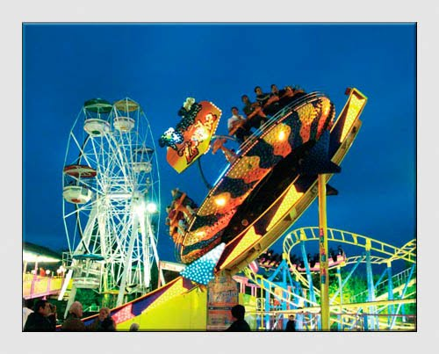
Write your own Pattern 5

Slide 23
The Twenty Patterns
Pattern 6: An Introductory Series Of Appositives
(with a dash and a summarizing subject)
Appositive, appositive, appositive – summary word S V.
(The key summarizing word before the subject may be one of these: such, all, those, this, many, each, which, what, these, something, someone. Sometimes the summary word will be the subject, but other times it will merely modify the subject.)

Slide 24
The Twenty Patterns
Pattern 6 Examples:
Twitter, Facebook, email – which should he use?
“What it comes down to is this: the grocer, the butcher, the baker, the merchant, the landlord, the druggist, the liquor dealer, the policeman, the doctor, the city father and the politician – these are the people who make money out of prostitution, these are the real reapers of the wages of sin.”
~ A House Is Not a Home

Slide 25
Write your own Pattern 6

Slide 26
The Twenty Patterns
Pattern 7: AN INTERNAL SERIES OF APPOSITIVES OR MODIFIERS
(enclosed by a pair of dashes or parentheses)
S - appositive, appositive, appositive - V .
OR
S ( modifier, modifier, modifier) V .
Examples:
My favorite red wines – Zinfandel, Cabernet Sauvignon, Pinot Noir – account for most sales in California.
The basic writing skills (good vocabulary, knowledge of grammar, sense of style) can be learned by almost everyone.

Slide 27
Write your own Pattern 7

Slide 28
The Twenty Patterns
Pattern 8: DEPENDENT CLAUSES IN A PAIR OR IN A SERIES
(at beginning or end of sentence)
If…, if…, if…, then S V .
When…, when…, when…, S V .
S V that…, that…, that… .
(omit the third clause and have just two, if you wish)

Slide 29
The Twenty Patterns
Examples:
Whether you feel sentence patterns are a waste of time or whether you feel sentence patterns are useless in real life application, you will improve your writing by learning to incorporate sentence patterns into your own communications. (anaphora)
“Though it was attached to a lead held by a man, and despite the fact that I had read in my book, How and Why Wonder Book on Wild Animals, that pumas do not usually harm people, I ran away as fast as I could.”
~ National Geographic

Slide 30
Write your own Pattern 8

Slide 31
The Twenty Patterns
Pattern 9: REPETITION OF A KEY TERM
_
S V key term or repeated key term.
,
(use dash or comma before repetition)
Examples:
He is part of the hip hop generation, a generation constantly moving. (anadiplosis)
“The man for whom law exists – the man of forms, the conservative – is a tame man.” ~ HD Thoreau

Slide 32
Write your own Pattern 9

Slide 33
The Twenty Patterns
Pattern 9a: A VARIATION: SAME WORDS REPEATED IN PARALLEL STRUCTURE
S V repeated key word in same position of the sentence.
Examples:
Venice presents great gifts to the visitor – great history, great art, great food. (parallel structure)
“No house should ever be on a hill or on anything. A house should be of the hill, belonging to it, so hill and house could live together each the happier for the other.” (symploce and chiasmus)
~ Frank Lloyd Wright

Slide 34
Write your own Pattern 9a

Slide 35
The Twenty Patterns
Pattern 10: EMPHATIC APPOSITIVE AT END, AFTER A COLON
S V word: the appositive (the second naming) .
(with or without modifiers)
Examples:
The vampire feared two things: the sun and mirrors.
“In perpetuating a revolution, there are two requirements: someone or something to revolt against and someone to actually show up and do the revolting.” ~Woody Allen, “A Brief, Yet Helpful Guide to Civil Disobedience”

Slide 36
Write your own Pattern 10

Slide 37
The Twenty Patterns
Pattern 10a: A VARIATION: APPOSITIVE
(single or pair or series)
AFTER A DASH
S V word - the appositive .
(echoed idea or second naming)
Examples:
One label would fit almost any teenager – student.
“Sometimes I need what only you can provide – your absence.” ~ Ashleigh Brilliant

Slide 38
Write your own Pattern 10a

Slide 39
The Twenty Patterns
Pattern 11: INTERRUPTING MODIFIER BETWEEN SUBJECT AND VERB
S , modifier , V .
S - modifier - V .
S (modifier that whispers) V .
Examples:
Condors – once almost extinct – have been saved by careful breeding.
“Sometimes children from other classes, those presumably not so intellectually gifted, would tease and taunt us.”
~ Michael T. Kaufman

Slide 40
Write your own Pattern 11

Slide 41
The Twenty Patterns
Pattern 12: INTRODUCTORY OR CONCLUDING PARTICIPLES
Participial phrase , S V .
S V , Participial phrase .
Examples:
Watching Star Wars for the first time, the small boy was anxious when R2D2 was attacked by the Jawas.
“ Announced by all the trumpets of the sky, arrives the snow.”
~ R W Emerson

Slide 42
Write your own Pattern 12

Slide 43
The Twenty Patterns
Pattern 13: A SINGLE MODIFIER OUT OF PLACE FOR EMPHASIS
Modifier , S V .
(modifier may be in other positions)
Examples:
Underneath, he could detect leaking oil.
“Breathless, we flung us on the windy hill.” ~Rupert Brooke

Slide 44
Write your own Pattern 13

Slide 45
The Twenty Patterns
Pattern 14: PREPOSITIONAL PHRASE BEFORE S AND V
Prepositional phrase S V (or V S) .
Examples:
Under the waterfall, we felt special.
“From the mist emerged a figure playing a flute.” ~ National Geographic, August 1988

Slide 46
Write your own Pattern 14

Slide 47
The Twenty Patterns
Pattern 15: OBJECT OR COMPLEMENT
BEFORE S AND V
Object or Subject complement S V .
Examples:
His kind of sarcasm I do not like. (DO)
Famous and wealthy an English teacher will never be. (Subject complement)
“Peace, it’s wonderful.” ~ Father Devine

Slide 48
Write your own Pattern 15

