Slide 1
The Art of Styling Sentences
Skill Comes From Practice

Slide 2
A note about dependent vs. independent clauses
Independent Clauses
Subject
Verb
Complete thought
Dependent Clauses
Subject
Verb
Incomplete thought

Slide 3
Examples of each type
Independent
Dependent
The concert was really fun.
Texas is better than Oklahoma.
Students make me happy.
When I was moshing,
Which made the Sooner cry.
Because I love Dr. Pepper.
Who bring me Dr. Pepper

Slide 4
The Twenty Patterns
Pattern 1: Compound Sentence with Semicolon and No Conjunction
(two short, related independent clauses now joined)
S V_ ; S V .
Examples:
Reading is the easy part; remembering takes more effort.
“My forefathers didn’t come over on the Mayflower; they met the boat.” ~Mark Twain

Slide 5
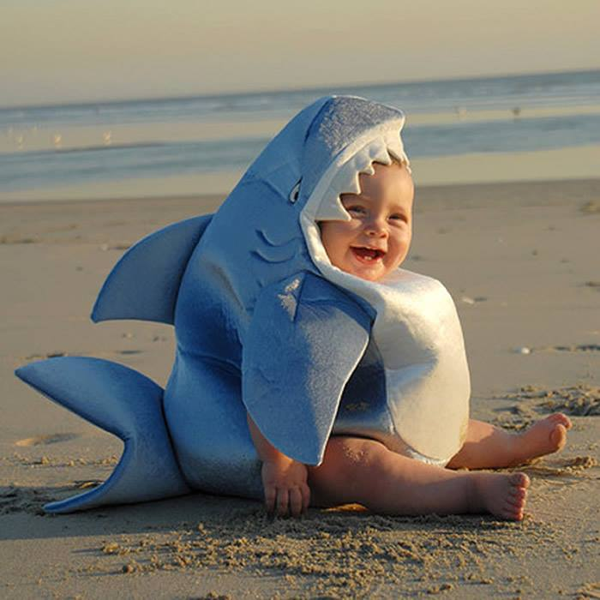
Write your own Pattern 1

Slide 6
The Twenty Patterns
Pattern 1a: Compound Sentence with Conjunctive Adverb (Connector)
S V ; (conjunctive adverb), S V
(You will need a semicolon before the connector, and a comma after the connector is often used, but optional.)
Examples:
Gary couldn’t go away for his vacation; however, he managed to have a good time at home.
“I think; therefore I am.” ~ Rene Descartes

Slide 7
Conjunctive Adverbs
however, hence, therefore, thus, then, moreover, nevertheless, likewise, consequently, and accordingly

Slide 8
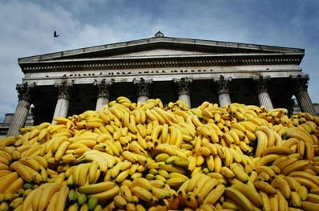
Write your own Pattern 1a

Slide 9
The Twenty Patterns
Pattern 1b: Compound Sentence with Coordinating Conjunction (Also Connector)
S V , (coordinating conjunction)
S V .
Examples:
The mouse ran across the floor, but I wasn’t scared.
“Good communication is as stimulating as black coffee, and it is just as hard to sleep after.” ~Anne Morrow Lindbergh

Slide 10
Coordinating Conjunctions
FANBOYS
for, and, nor, but, or, yet, or so

Slide 11
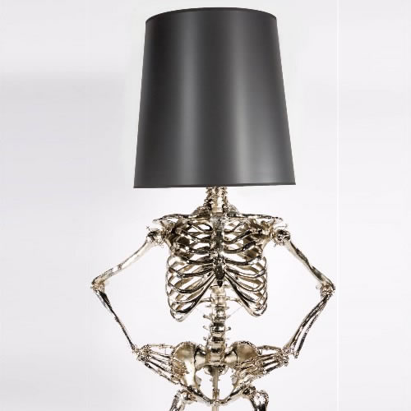
Write your own Pattern 1b

Slide 12
The Twenty Patterns
Pattern 1c: Compound Sentence with Two or More Semicolons
S V ; S V ; S V .
Examples:
Carmen likes to cook; Janice would rather watch TV; I like to eat while watching TV.
“He was naturally learned; he needed not the spectacles of books to read Nature; he looked inwards and found her there.” ~ John Dryden

Slide 13
Write your own Pattern 1c

Slide 14
The Twenty Patterns
Pattern 2: Compound Sentence with Elliptical Construction (comma indicates the omitted verb)
S V DO or SC ; S , DO or SC .
(omitted verb)
Examples:
For many of us, the new math teacher was a savior; for others, a pain.
“Thought is the blossom; language[,] the bud; action [,] the fruit.” ~ Ralph Waldo Emerson

Slide 15
DO- Direct Object
Receives the action of the verb
He threw the ball.
The zombies ate the corpse.
SC- Subject Complement
Describes the subject
The girl is fascinating.
Ms. Kelley is a teacher.

Slide 16
Write your own Pattern 2

Slide 17
The Twenty Patterns
Pattern 3: Compound Sentence with Explanatory Statement (clauses separated by a colon)
General statement (idea) : specific statement (example).
(an independent clause) (an independent clause)
Examples:
The bouquet was special: it contained the roses she loved best.
“Old cars and young children have several things in common: both are a responsibility and have to be fed often or they break down.” ~ Claudia Glenn Downing

Slide 18
Write your own Pattern 3

