Slide 1
Research: Finding and Citing Sources
Stephen F. Austin High Library
Notes:
See http://www.2facts.com/icof_story.aspx?PIN=ircs00000004

Slide 2
Clarify Your Topic
When considering a topic, check the availability of several reliable sources; you may need to revise your proposed topic if you cannot find sufficient research material.
Consult a general reference source, such as a dictionary, encyclopedia, or glossary to get an overview of the issues and identify keywords and names to help you search.
Identify both broad and narrow terms; identify any specialized vocabulary unique to your topic to use in your assertion paper.

Slide 3
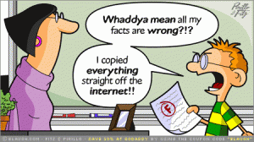
Examine Sources & Gather Notes
Browse bibliographies and works cited; use databases to search for articles.
Review several sources; evaluate their credibility based on authorship, publication, bias, etc.
Use quotations in your notes to indicate direct quotes and record the source!
Image from http://www.plagiarismchecker.net/page/2/
Notes:
Utilize bibs/reading lists, may contain digital documents, may need to use citation to look up articles in databases.
Facts help produce a strong appeal; Credible sources helps establish ethos…
It’s a good idea to record quotes and facts separately from your own questions, thoughts and ideas.

Slide 4
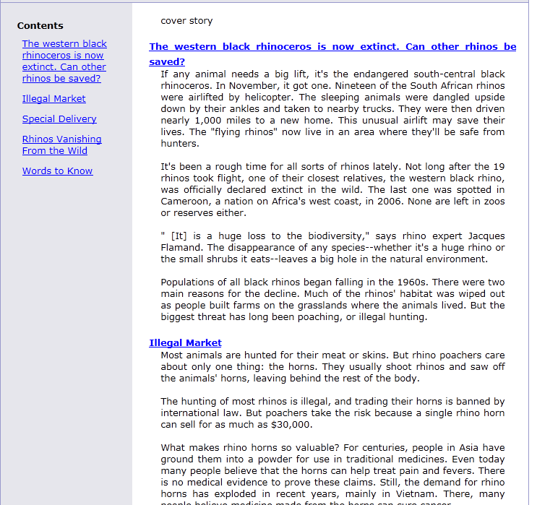
Using Databases
PDF
Search multiple publications at once with databases, such as:
General reference sources give definitions and broad overviews:
HTML
Web site

Slide 5
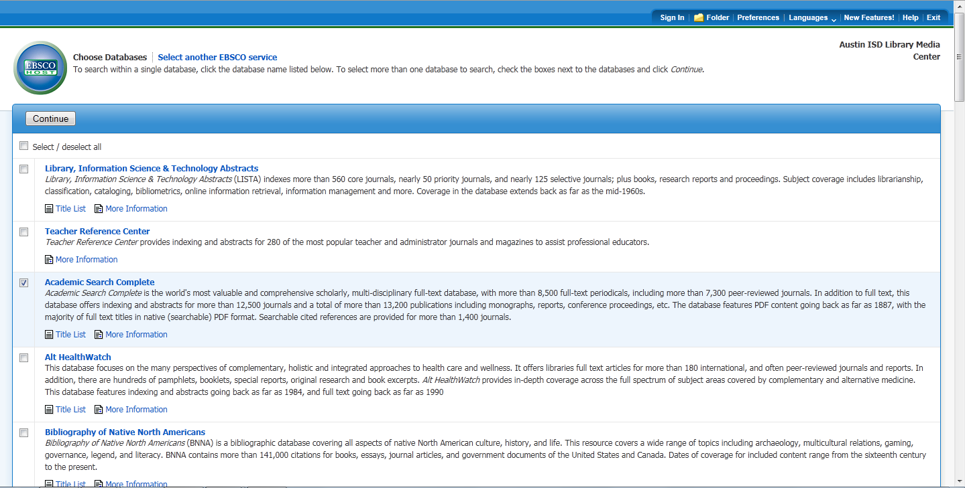
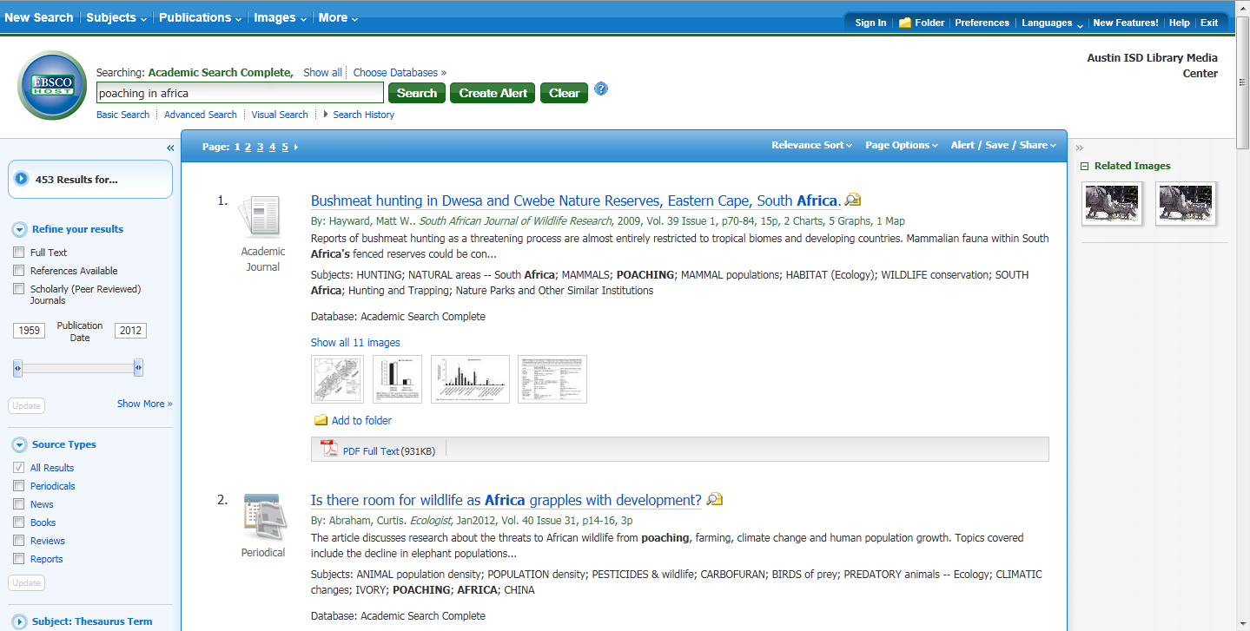
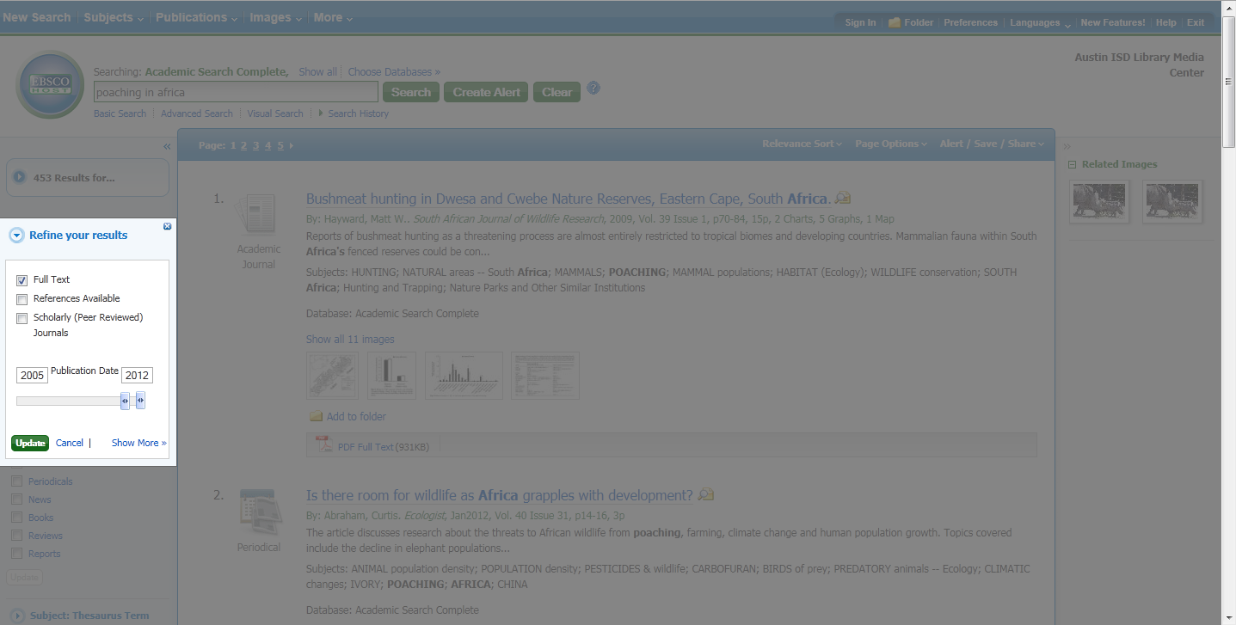
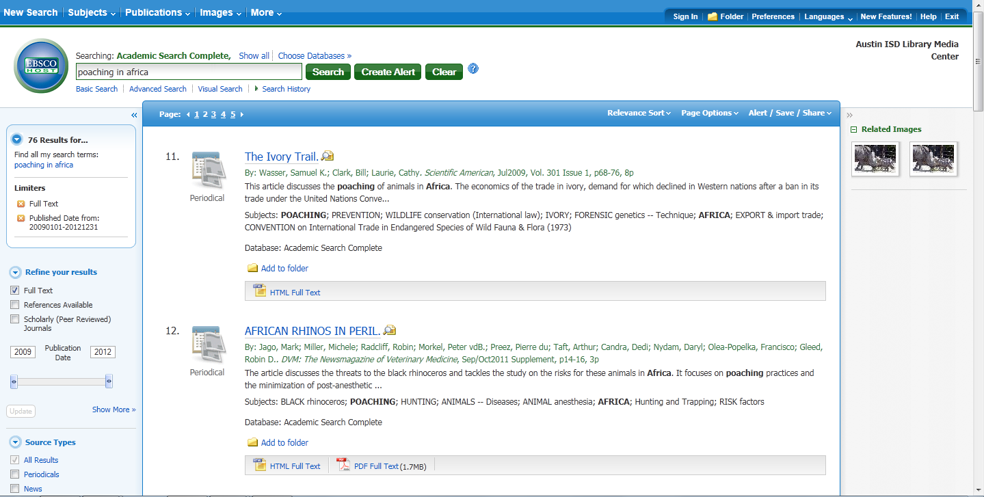
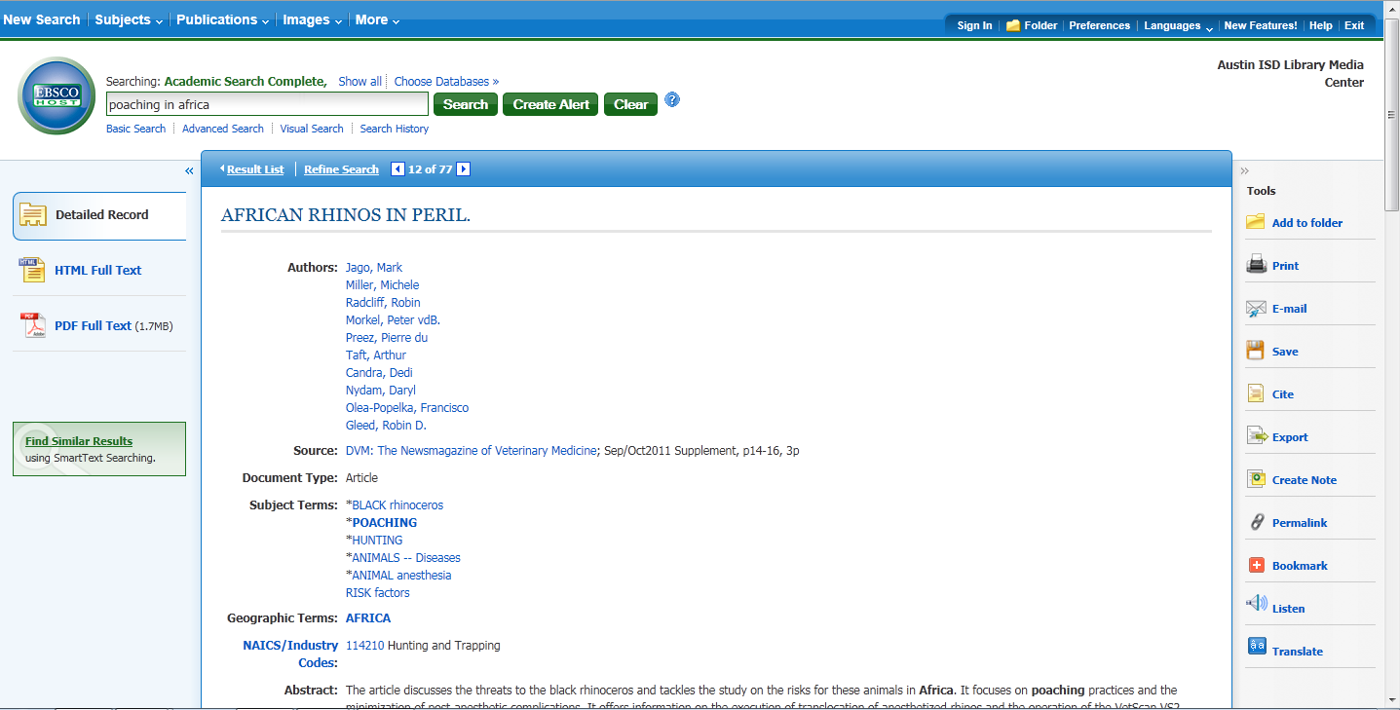
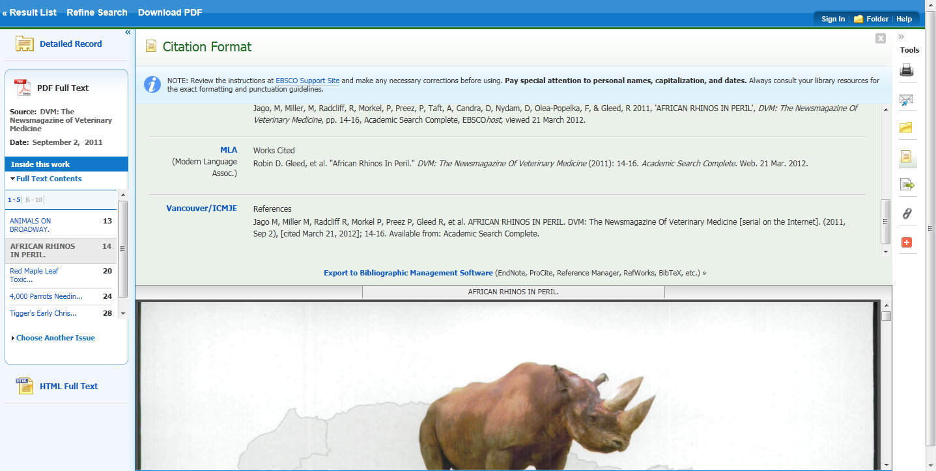
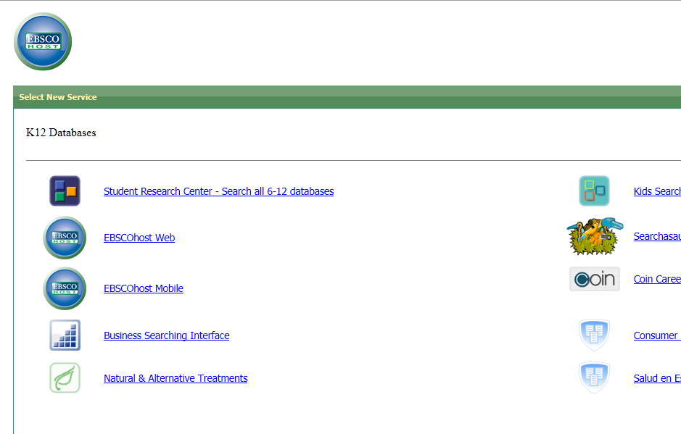
EBSCO Databases
I
(Video tutorial available on AHS library web page, under Online Research Tools)

Slide 6
The Importance of Citing Sources
Acknowledge the source of your information: any ideas, direct quotes, photos or other graphic aids used.
Aid readers by indicating where your sources can be found.
Show that you are well-read and that you have thoroughly researched your topic.
Protect your own original ideas by indicating what is gathered and what ideas you have developed on your own.
(adapted from Facts on File news Service, 2012)

Slide 7
MLA Citations, When and What?
You MUST cite when you:
Use a direct quote of more than 2 words
Paraphrase another author’s ideas
Include unfamiliar facts
Use graphics or multimedia sources
For each source you cite, provide the following:
Author(s) Name(s)
Title of Work (article and journal)
Publication Info (date, location, issue)
Web Site (address and date accessed)
Use your Yellow Pages!

Slide 8
Where do citations go?
Parenthetical citations are used in the body of text, following another author’s content.
(LastName #)
It depends on your project, but they have to go somewhere!

Slide 9
Other Research Resources
Surveys!
Pass out ones that you make
Informal surveys
Interviews
Record on your phone
Polls
Polleverywhere.com
Books
Real books… like from the library
Experts
Email them, call them, go meet them in person?

Slide 10
Collaboration Resources
Google Docs
Doodle
Cozi
Wunderlist

