Slide 1
Deconstructing the “E” in ACE

Slide 2
Open your RAW Book to the “Notes” section
As a reminder, write out ACE
What does each letter stand for?

Slide 3
E- Explanation
The reader can infer that _______________
What does infer mean?
To conclude based on evidence

Slide 4
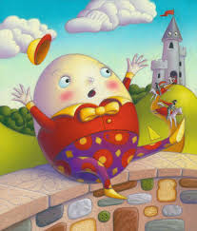
Humpty Dumpty
Humpty Dumpty sat on a wall,
Humpty Dumpty had a great fall;
All the king's horses and all the king's men
Couldn't put Humpty together again.

Slide 5
Inferring Example
Why did the king’s men and horses try to repair Humpty Dumpty?
The king’s men and horses tried to repair Humpty Dumpty because he was broken. After he “had a great fall,” “all of the king’s horses and all of the king’s men tried to put [him] together again.” The reader can infer that all of the men and horses cared for him as a community because the writer uses the word “all” and they collectively served the same king.

Slide 6
Now you try one
Hickory, dickory, dock.
The mouse ran up the clock.
The clock struck one,
The mouse ran down,
Hickory, dickory, dock.
Why did the mouse run down the clock?

Slide 7
The reader can infer that…
Tell us what the text doesn’t say explicitly
Read between the lines
Because you’re a good, insightful reader, what can you tell based on what the author’s saying?

