Slide 1
Sentence Types

Slide 2
Independent vs. Dependent Clauses Reminder
Independent Clauses
Subject
Verb
Complete thought
Dependent Clauses
Subject
Verb
Incomplete thought

Slide 3
Simple Sentences
A simple sentence contains only one independent clause and no dependent clauses.
Example:
Coffee is delicious.
I love reading books and watching television.
Lessons about grammar fascinate boys and girls.

Slide 4
Write your own simple sentence about this picture:

Slide 5
Compound Sentences
Contain two or more independent clauses.
Examples:
I love answering questions about English; your curiosity is wonderful.
Popeye’s is okay, but Chick-fil-a is the best.
I want you all to become great writers; therefore, it is important that you learn the rules of grammar.

Slide 6
Write your own compound sentence about this picture:

Slide 7
Complex Sentences
A complex sentence has one independent clause and one dependent clause.
Examples:
I like coming to Austin High because we have so much tradition.
When I sit in English class, my eyelids start to weigh a thousand pounds.
I read To Kill A Mockingbird, which Harper Lee wrote.

Slide 8
Write your own complex sentence about this picture:

Slide 9
Compound-Complex Sentences
A compound-complex sentence has two or more independent clauses and at least one dependent clause.
Examples:
Because she arrived first, Kirsten was in charge of the room, but she left it unattended.
We try to make grammar fun, but the students, who don’t care much for school anyway, just groan whenever there is a grammar lesson.

Slide 10
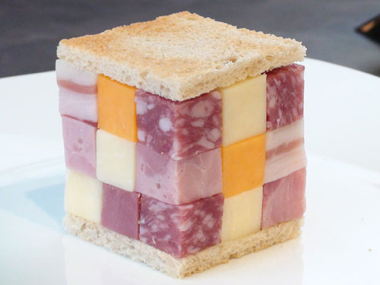
Write your own compound-complex sentence about this picture:

