Slide 1
“Why Chicken Means So Much to Me”
Vocabulary in Context

Slide 2
Setting up your raw Book
Put your name and period on the front of your RAW book
This will stay with me in our classroom all year
Now flip to the first page. At the top of the page write:
The Date The Title
9/1 “Chicken”: Vocab in Context

Slide 3
In your notebook, write the definition of the following word:
Thrish

Slide 4
What do you think?
What’s difficult about figuring out the meaning of the word I just showed you?
Let’s look at it again…

Slide 5
My daughters love Thrish.
Now, what do you think “thrish” means? Why?

Slide 6
Good thinking, but Let’s look at it again.
My daughters like to eat thrish after dinner.
Guesses now?
Getting closer! But let’s look at the sentence one more time.

Slide 7
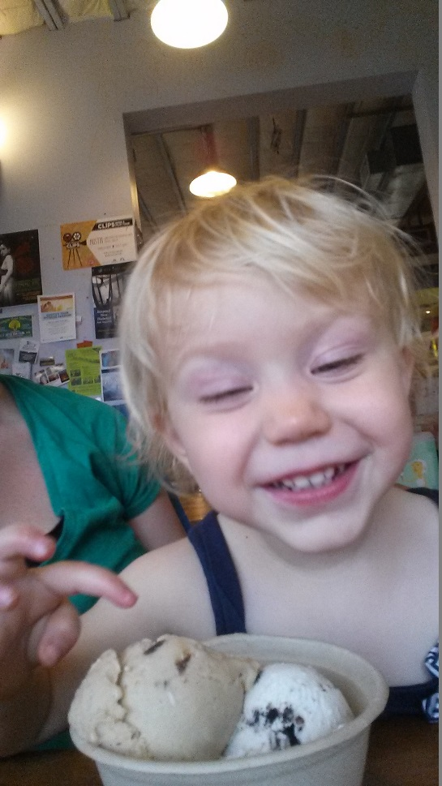
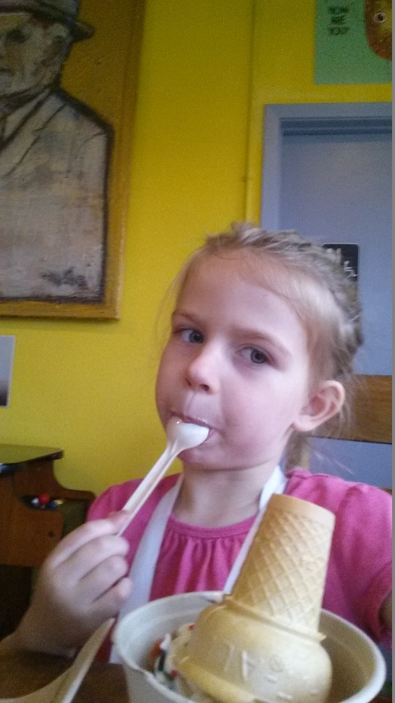
After dinner, My daughters like to eat Thrish with chocolate syrup and a cherry on top. And so your final answer is…

Slide 8
Obviously, what changed That made it easier to figure out the definition?
Thrish
My daughters love thrish.
My daughters like to eat thrish after dinner.
After dinner, my daughters like to eat thrish with chocolate syrup and a cherry on top.

Slide 9
Luckily, there are six strategies you can use when trying to figure out the meaning of a word with context clues.
1. The word is defined in the sentence. | All life on earth can be credited to photosynthesis, where plants convert sunlight into food.
2. An example of the word meaning is given in the sentence. | He is so opinionated that he won’t even consider the ideas or suggestions of others.
3. The unknown word can be substituted with a known word that is a good fit with the rest of the sentence. | Why’d you do it? I didn’t aim to.

Slide 10
Context Clue Strategies--continued
4. The unknown word is renamed in the sentence (a synonym is given). | She bent down enough to permit him to stoop and pick up her purse.
5. The opposite of the unknown word is named in sentence. | Instead of driving steadily in her lane, she careened over the curb.
6. The unfamiliar word can be broken into familiar parts--prefix-root-suffix. | My anger subsided in a few minutes.

Slide 11
Now--A disclaimer
On the following slides, you will see some sentences from “Why Chicken Means So Much to Me.”
You probably will know the meaning of most if not all of the underlined words already. That’s ok.
For this activity, we want you to pause and look at which words around the underlined word help give clues to its meaning.
One step at a time…

Slide 12
“Why Chicken” Context Clues
Word in Context | Definition | Which Strategy(ies) Used
1. I thought he just had heat exhaustion or something. I mean, it was a crazy-hot July day … and plenty of people were falling over from heat exhaustion, so why not a little dog wearing a fur coat? | Exhaustion-- | a. Definition b. Example c. Substitution d. Renamed e. Opposite Named f. Prefix-root-suffix
2. I figured he’d be okay with some rest, but then he started vomiting, and diarrhea blasted out of him, and he had these seizures where his little legs just kicked and kicked and kicked. | Seizures-- | See options above.

Slide 13
Word in Context | Definition | Context Clue Strategy
3. But I can’t blame my parents for our poverty because my mother and father are the twin suns around which I orbit and my world will EXPLODE without them. | Orbit-- | Definition Example Substitution Renamed Opposite named Prefix-root-suffix
4. And then you start believing that you’re stupid and ugly because you’re Indian. And because you’re Indian you start believing you’re destined to be poor. | Destined-- | See options above.

Slide 14
Word in Context | Definition | Context Clue Strategy
5. He knew what Dad was going to do. But Oscar wasn’t scared. He was relieved. | relieved-- | Definition Example Substitution Renamed Opposite named Prefix-root-suffix

Slide 15
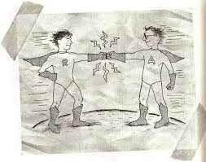
The Take Away:
This year, as we practice using context clues, we are not just interested in if you know what the word means. We also want you to point out how the context shows you what the word means.

