Slide 1
Expanding SENTENCES
Tools Section

Slide 2
I bought some things at the store.
How would you describe the sentence below?

Slide 3
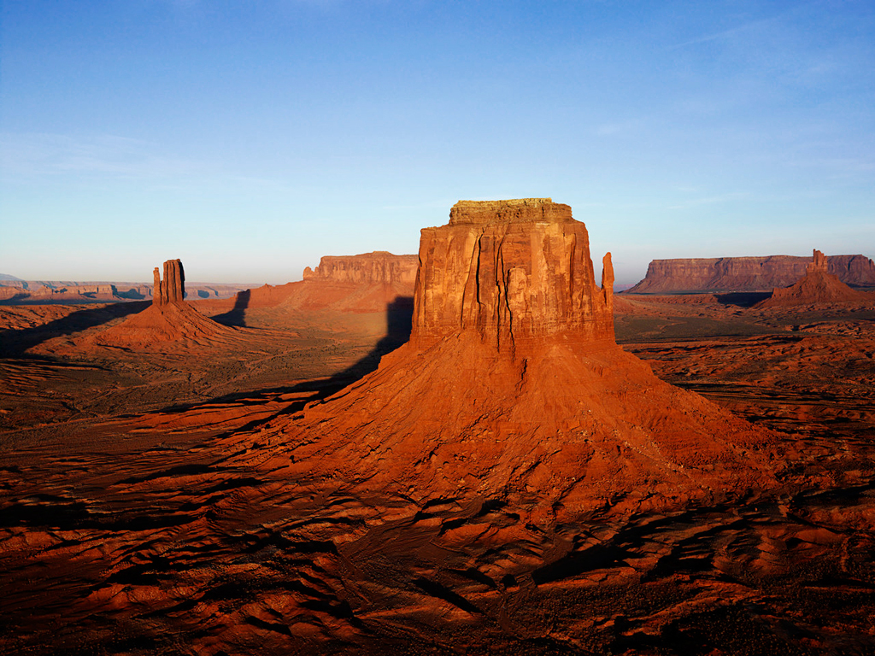
Like this desert, that sentence was dry! ☺
What specific things could we add to make this sentence more informative to the reader?
When did you buy some things?
What did you buy?
What store did you go to?

Slide 4
Your Goal is to write sentences that give significant details to your readers in a clear, concise manner.
Dry Sentence
Expanded Sentence
I bought some things at the store.
Last night I bought squash, ice cream, and bananas at the new H-E-B in the Mueller Development.

Slide 5
Composing concise yet adequately informative sentences take PRACTICE!
Take heart!

Slide 6
Let’s look at this example--
The chorus was preparing for a concert.
Now, let’s add a word or words that describe what kind of chorus.
The school chorus was preparing for a concert.
Let’s also add a word or words that describe which concert.
The school chorus was preparing for the Spring concert.

Slide 7
Now, in your raw book, Expand upon the following sentences:
A pioneer family settled there.
Add your own words that tell where they settled.
The first thing they did was to build a cabin.
Add your own words that tell where they built their cabin.
Add your own word or words that describe the cabin.
The family constructed the cabin out of logs.
Add your own words that tell where the logs came from.
They filled the cracks with moss and clay.
Add your own words that tell where the cracks were.

