Slide 1
Basic structure of an argument

Slide 2
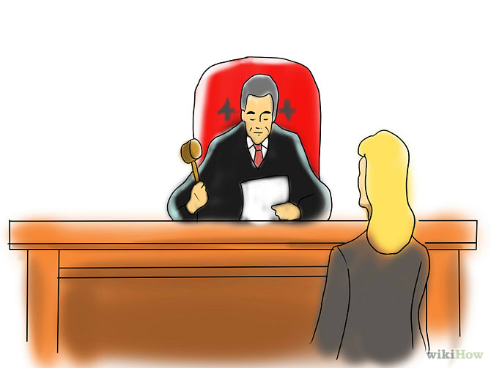
Claim
Assertion about a controversial question or topic
People might disagree

Slide 3
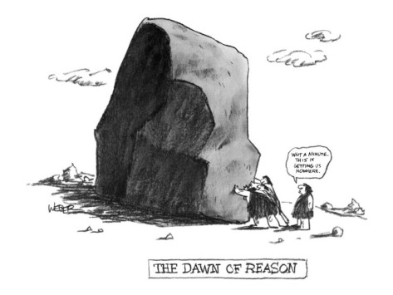
Reasons
The why behind the claim
Either includes the word “because” or could be easily inserted
Reasons are also claims in and of themselves

Slide 4
Grounds
Evidence
How do you know?
Anything used to persuade an audience that a claim is true

Slide 5
Sample Argument
Claim: Malala Yousafazi’s 18th birthday should be celebrated more than Kylie Jenner’s.
Reason: Malala is more globally influential and altruistic than Kylie.
Grounds
On her 18th birthday, Malala, the youngest Nobel Prize laureate, opened another school, this one serving 200 Syrian girls.
Kylie Jenner celebrated her 18th birthday by partying with her boyfriend Tyga and the infamous Kanye West.

Slide 6
Looking back at the Wellesley speech
What was McCullough’s basic argument?
Claim
Reasons
Grounds

